Slide 1


Google Analytics Customer Revenue Prediction
Machine Learning Project
Bijayalaxmi kar

Slide 2
Objectives:
As for every business, the number of customer that generate revenue will be far less than the total customers that the business interacts with. So for every business it's really important to understand, analyse and predict the areas of its revenue generation
In every business it was proven about 80–20 rule., this rule tells us 80% of our revenue will be generated by only 20% of our potential customers. So our goal is to predict the revenue that is going to be generated by those potential customers in the near feature. So that marketing teams will invest appropriate money on promotional strategies to attract potential customers.
.

Slide 3
Benefits:
Analyze a Google Merchandise Store (also known as GStore, where Google swag is sold) customer dataset to predict revenue per customer.
The outcome will be more actionable operational changes and a better use of marketing budgets for those companies who choose to use data analysis on top of GA data
Analyzing shopping behavior of customers can help the service providers offer differentiated information to customers and improve their shopping experience also.

Slide 4
Data Sharing Agreement:
Sample file name(Ex:customerevenuepredict_02082021_010101)
Length of date stamp(8 digits)
Length of time stamp(6 Digits)
No of columns,column names
Columns Data type
Column Details
Data mining(The csv files contains some filed with json objects and These features need to be flattened out)

Slide 5
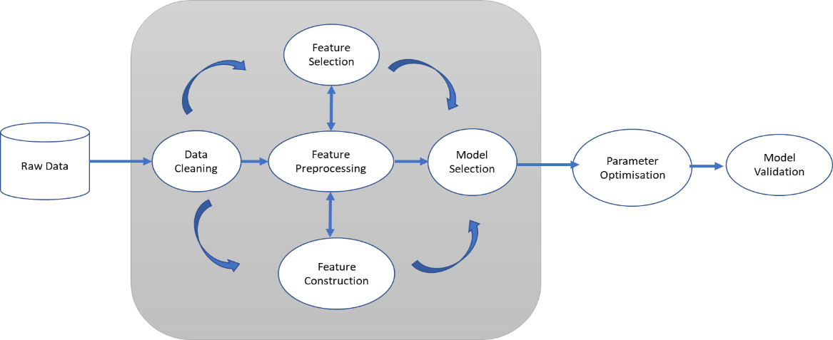
Application Architecture:

Slide 6
Data Validation & Data Transformation:
File Name Validation :File name validation as per the DSA. We have created regular expression pattern for validation with time stamp format. IF this file satisfy the pattern criteria it will go to valid_data_file folder or else it will go to bad_data file folder.
Name and no. of columns: It will check for number of columns and Name of the columns.If it will pass the validation criteria then it will goto valid_data_file or else bad_data_file.
Data types of column:The data types of column is given in schema file is valid or not.
Null values in Columns:If any columns in file contain null values or data ids missing then this file is going to bad_file_folder.

Slide 7
Data Insertion In Database:
Table Creation: we have to create a table in Database to insert valid data files ,if Table is already created then we need to insert new files into database.
Insertion: All valid files are inserted into the tables.

Slide 8
Model Training:
Data export from DB:
Data export from database table as csv format.
Exploratory Data Analysis & Data Pre-processing:
Missing value count
No of rows and columns
categorical/Neumerical columns
Correlation heat map
Null value handling(impute null value)
Outlier detection and remove
Perform standard scalar for scaling down
Time-series featurization

Slide 9
Model Selection:
Here we are using two models for building final that will predict revenue:-
Classification Model to predict whether customer would return during test window.
Regression Model to predict transaction amount.
predicted revenue = classification model output(probability)* regression model output(real value)
Hyper-parameter tuning for classification model & as well as for regression model :
We are building classification model and regression model on the best hyper-parameter values that we got and we run for multiple times(let say 10) and we are taking the average value of all the predictions generated in each iteration.
We tried XGBOOST, lightbgm and catboost

Slide 10
Future work:
If we were given with the actual totals.transactionRevenue, then we could train a model by taking test predictions from various time frames into a vector(10 in this case) and the actual totals.transactionRevenue as target variable.
As you can see, we have split the entire data into number of segments based on time. But we have taken the average of all the test predictions we got from various time frames , we have taken the average that means we are giving equal importance to all the time frames.

Slide 11
Q & A
Q1:Explain about the Project and your day to day task :
A:It is a retail domain project, the number of customer that generate revenue will be far less than the total customers that the business interacts with. So for every business it's really important to understand, analyse and predict the areas of its revenue generation. So our goal is to predict the revenue that is going to be generated by those potential customers in the near feature. So that marketing teams will invest appropriate money on promotional strategies to attract potential customers.
As a data scientist I am involving in each an every phase of the project.
My first job is checking my office mail and reply the corresponding mail and after that run several jobs to get data to understand a discrepancy in metrics, write code to feed data from some third party ,APIs into our data lake. Worked in the code the rest of the day. Mixed in are calls, stand ups and the attending scrum meeting.

Slide 12
Q & A
Q2:What is the source and size of data
A:The data for train is provided by client in batches.Size of the data usually in MB.
Q3:What was the team size
A:It is the size of 10 with manager ,solution archtech,Developers,Datascintist.
Q4:How were u creating and maintaining the log:The Logs ar e used in Casandra.
Logs are an essential part of troubleshooting application and infrastructure performance. Logs are not only to capture the state of our program but also to discover possible exceptions and errors.

Slide 13
Q & A
Q5:What techniques r you using for data preprocessing
A:Removing unwanted attributes.
Visualizing relation of independent variables with each other and with dependent variable.
Removing Outliers.
Cleaning data and imputing if null values are present.
Convering Categorical data to neumerical data.
Scaling the data.

Slide 14
Q & A
Q6:How were you maintain the failure cases?
A:If our model is not predicting correctly for data then that dataset goes to database . There will be a report triggered to the support team at the end of the day with all failure scenarios where they can inspect the failure. Once we have a sufficient number of cases we can label and include those data while retraining the model for better performance.
Q7:In which technology you are most comfortable?
I have worked in almost all the fields like machine learning Deep learning and NLP. But personally I prefer deep learning.
Q8:What Kind of challenges have u faced during the project?
A:The biggest challenge I face in project is in obtaining good dataset,cleaning it to be fit for model and then labeling prepared dataset.Labeling is a time consuming task and it takes lots of our.Then comes the task of finding the correct algorithm to be used for business case.

Slide 15
Q & A
Q9:What will be your expectations?
A:I expect to work on different projects to enhance my technical skill and learn new things simultaneously.
Q10:What is your future objective?
A:My future objective is to learn new things in AI field because it changes continuously and my aim is to parsue my carrer as a solution architect near future.

